Slide 1
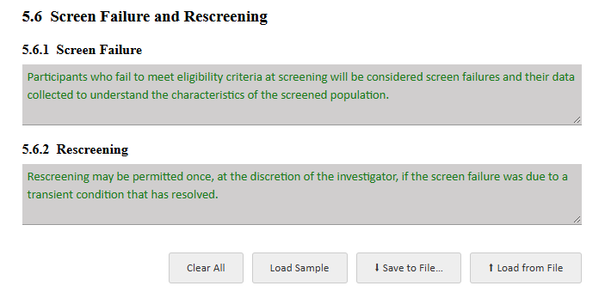
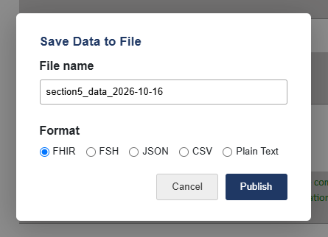
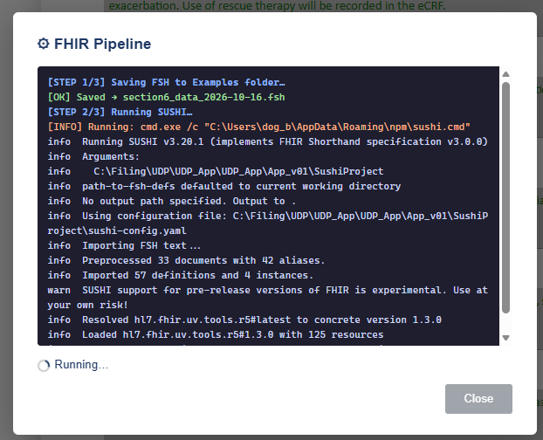
Choose a section Load Sample populates form with sample data
Save to File brings up a dialog. The FHIR option starts a pipeline running
If the pipeline ends in success there will be files in the build section
Files sent to Sushi Runner and to Build are cumulative so you can build a bundle of everything. If you don’t want that clear them before the next Save to FIle

Slide 2
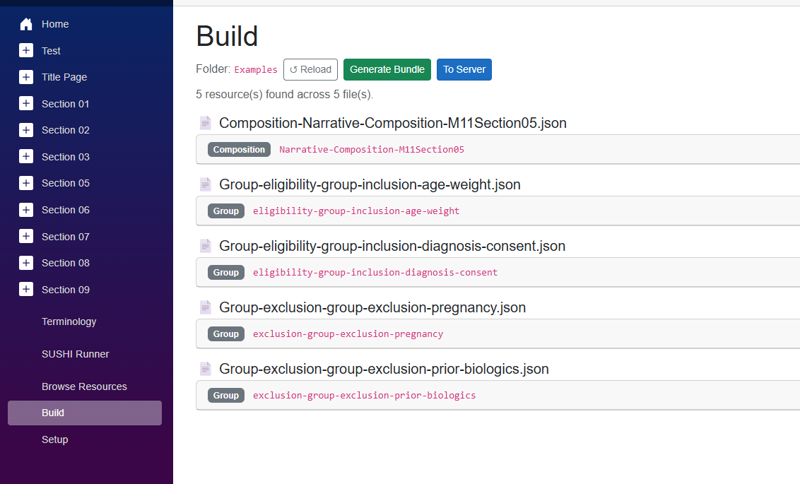
Generates Bundle and To Server do what they say
The resources created by the bundle are as listed – in the example a composition and 4 groups
If the load to server fails currently you have to use Postman to work out why.

Slide 3
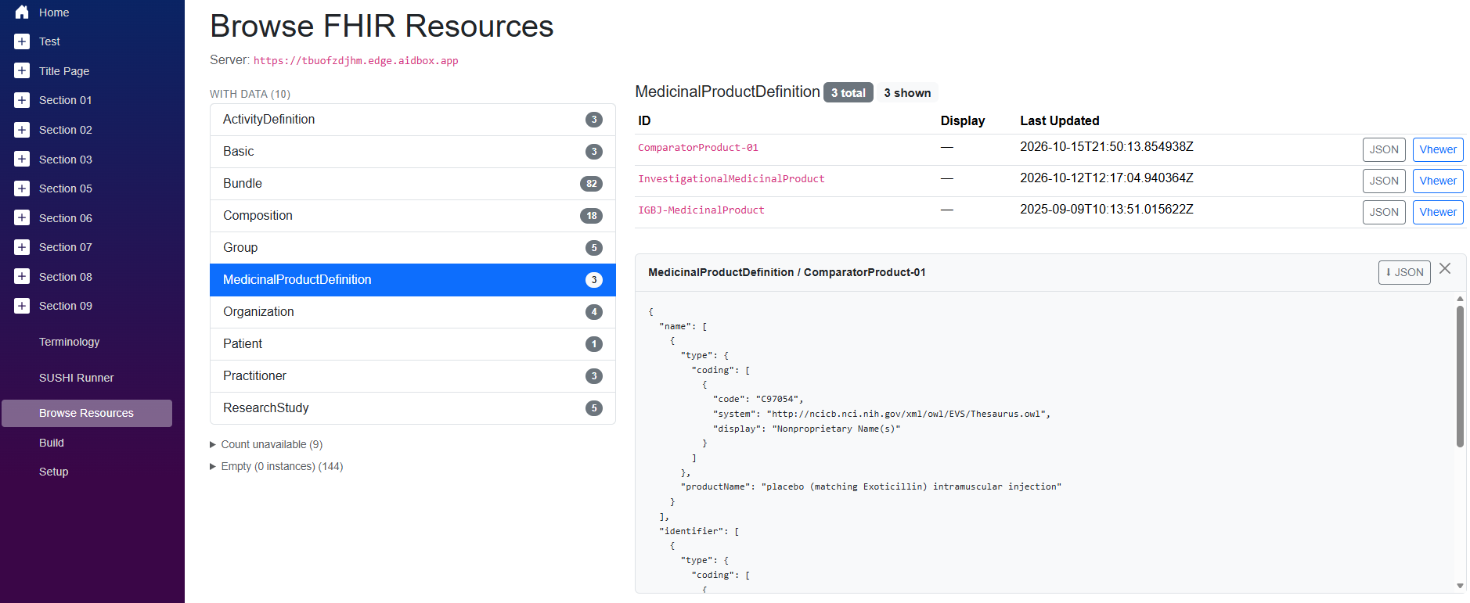
Browse Resources shows what is on the server.
Resources are most recent first
The JSON view is at the bottom of the display – scroll down to get it. Vhewer is in a separate window

